Slide 1
Notes:
This image over the background is a PNG- it isn’t included in the master slides anywhere, but it is in the master folder.

Slide 2
Pray for a National Spiritual Awakening that God will pour out His Spirit on Americans to repent of their sins and turn to God with all their heart Pray for Racial Reconciliation that God will heal our national wound of racism, and that God will use the church to stand against racial conflict, violence, and prejudice

Slide 3
Notes:
This image over the background is a PNG- it isn’t included in the master slides anywhere, but it is in the master folder.

Slide 4
List 3 reasons why you care about the Bible or why you want to read it or know it better.

Slide 5
Why we care about the Bible
True and Trustworthy

Slide 6
Psalm 119:151,160 You are near, O Lord, and all Your commandments are truth… The sum of Your word is truth, and every one of Your righteous ordinances is everlasting.

Slide 7
Mark 8:32-33 And Peter took [Jesus] aside and began to rebuke Him. But turning around and seeing His disciples, [Jesus] rebuked Peter and said, “Get behind Me, Satan; for you are not setting your mind on God’s interests, but man’s.”

Slide 8
Why we care about the Bible
True and Trustworthy
Unchanging

Slide 9
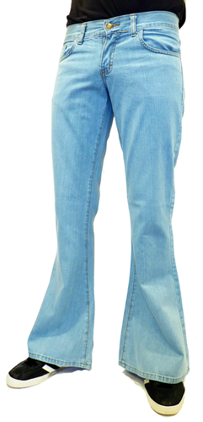
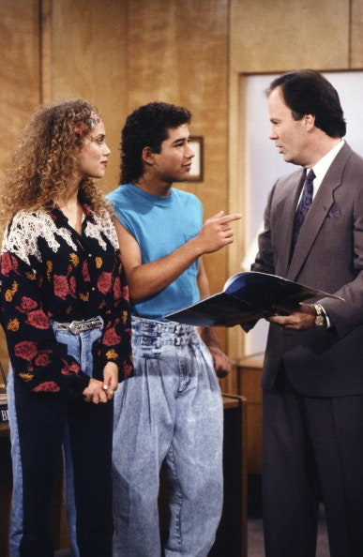
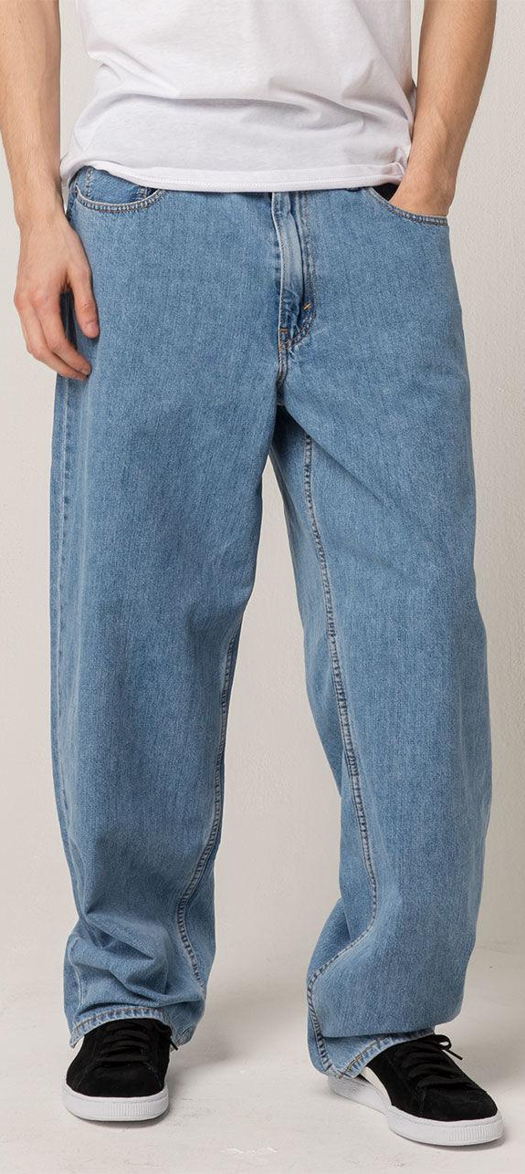
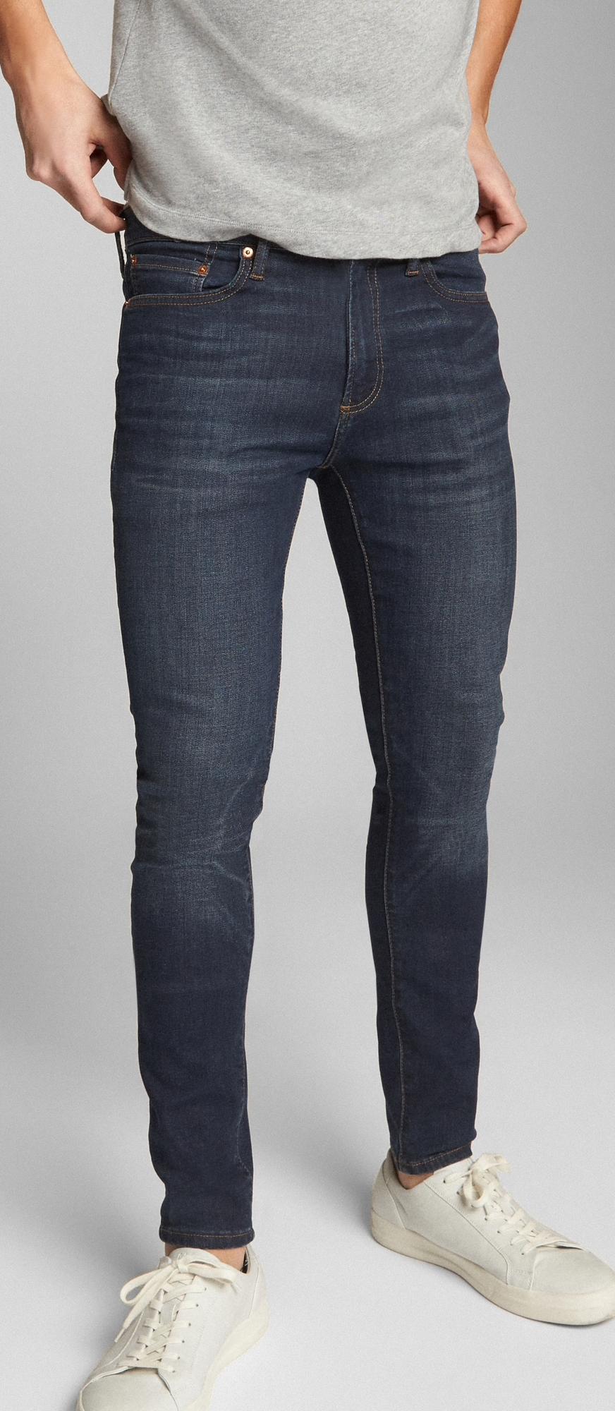

Slide 10
Isaiah 40:8 The grass withers, the flower fades, But the word of our God stands forever.

Slide 11
Matthew 5:18 “For truly I say to you, until heaven and earth pass away, not the smallest letter or stroke shall pass from the Law until all is accomplished.”

Slide 12
Why we care about the Bible
True and Trustworthy
Unchanging
Leads to salvation

Slide 13
Hebrews 4:12 For the word of God is living and active and sharper than any two-edged sword, and piercing as far as the division of soul and spirit, of both joints and marrow, and able to judge the thoughts and intentions of the heart.

Slide 14
Why we care about the Bible
True and Trustworthy
Unchanging
Leads to salvation
Equips us for life

Slide 15
Psalm 119:98-99 Your commandments make me wiser than my enemies, for they are ever mine. I have more insight than all my teachers, for Your testimonies are my meditation.

Slide 16
Psalm 119:11 Your word I have treasured in my heart, that I may not sin against You.

Slide 17
Why we care about the Bible
True and Trustworthy
Unchanging
Leads to salvation
Equips us for life
Gives us hope even in our darkest days

Slide 18
Romans 15:4 For whatever was written in earlier times was written for our instruction, so that through perseverance and the encouragement of the Scriptures we might have hope.

Slide 19
Why we care about the Bible
True and Trustworthy
Unchanging
Leads to salvation
Equips us for life
Gives us hope even in our darkest days

