Slide 1

Notes:
This image over the background is a PNG- it isn’t included in the master slides anywhere, but it is in the master folder.

Slide 2
Bibliology Topics
Canonicity – What books belong in the Bible?
Reliability – Is the Bible a reliable historical document?
Revelation – Is the Bible actually God’s Word?
Inspiration – How did God communicate the Bible to us?
Inerrancy – Is the Bible entirely truthful?

Slide 3
Canonicity
What books belong in the Bible?
Why these 66 books and not others?
What about the apocrypha?
What about other gospels?

Slide 4
Old Testament Canonicity
39 Books
  The Law = Pentateuch = Genesis-Deuteronomy
  The Prophets
  The Writings = Job, Psalms, Proverbs, Ecclesiastes, Song of Sol.
1000 years in the making (Moses: ~1450 BC to Malachi: ~450BC)

Slide 5
Old Testament Canonicity
The Law: recognized as canon immediately
Writings and Prophets: gradual recognition
So the Jews lived with an unfinished bible throughout OT
Jews formalized OT canon in 90AD council of Jamnia
Christians accepted it w/o question

Slide 6
The Apocrypha
Intertestamental Jewish literature
  Total number debated, but around 13
  Includes histories like 1 & 2 Maccabees
  Includes teachings like Sirach and Tobit
  Includes stories like Judith and Bel and the Dragon

Slide 7
The Apocrypha
Roman Catholics → scripture
Jews and Protestants → helpful, but not scripture
  Some stories seem clearly fictional (e.g. Judith)
  Some support for incorrect doctrines (e.g. purgatory)
  BUT very useful for understanding Jewish history and New Testament background!

Slide 8
New Testament Canonicity
27 books
3 “tests” for inclusion
  Written by or under an apostle
  Conforms to teachings of Jesus and the apostles
  Accepted and used as scripture by entire church

Slide 9
New Testament Canonicity
Little need to decide till 2nd century heresies
The church’s rule: if in doubt, throw it out
So the NT started smaller and grew over time
  Undisputed books: 4 gospels, Acts, Paul’s letters
  Disputed books: Hebrews, James, 2 Peter, Revelation
  No books dropped out! No “missing gospels”!
Canon complete by synod of Hippo 393 AD

Slide 10
Reliability
Is the Bible a reliable historical document?
How does the Bible stack up against other ancient literature?
Can we trust the Bibles we have today since we don’t have any of the original manuscripts?

Slide 11
Old Testament Reliability
Complex, fascinating topic
  Archeology: Dead Sea Scrolls
  Theology: fulfilled OT prophecies (e.g. many in Daniel)
  Culture and language: careful process of text transmission
Ultimate reason to trust the Old Testament…
The only Person to rise from the dead trusted it!

Slide 12
Matthew 5:17-18
“Do not think that I came to abolish the Law or the Prophets; I did not come to abolish but to fulfill. For truly I say to you, until heaven and earth pass away, not the smallest letter or stroke shall pass from the Law until all is accomplished.”

Slide 13
Old Testament Reliability
Complex, fascinating topic
  Archeology: Dead Sea Scrolls
  Theology: fulfilled OT prophecies (e.g. many in Daniel)
  Culture and language: careful process of text transmission
Ultimate reason to trust the Old Testament…
The only Person to rise from the dead trusted it!
  Evidence for resurrection is evidence for OT reliability
  grace-bible.org → articles → How we know that Jesus rose

Slide 14
New Testament Reliability
Manuscript Evidence
Internal Evidence
External Evidence

Slide 15
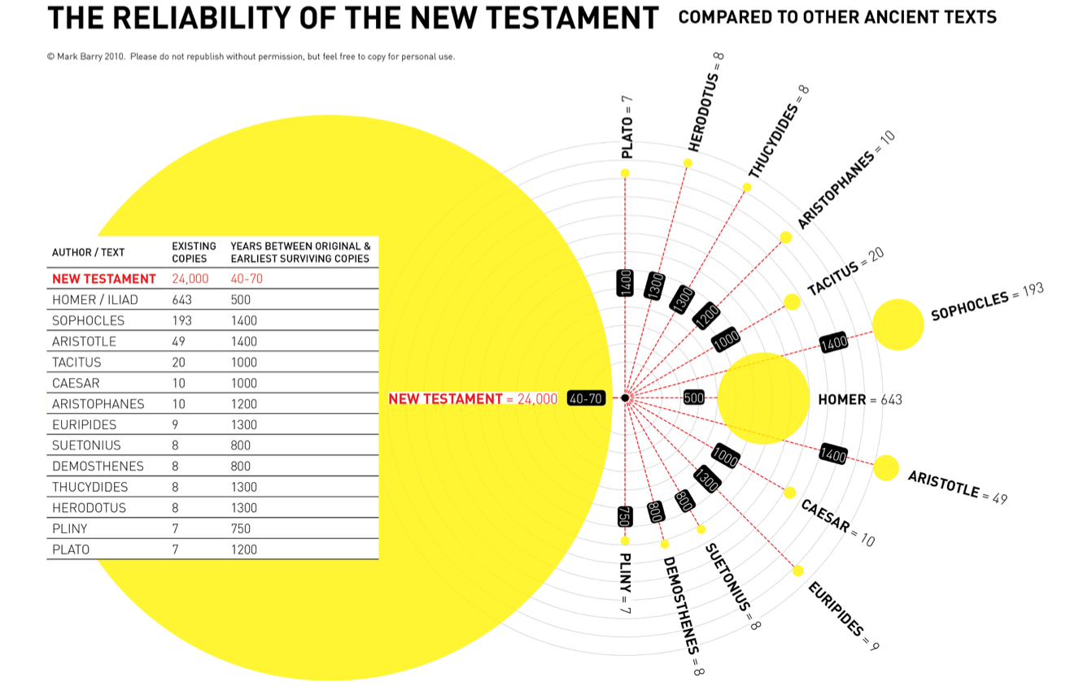

Slide 16
Manuscript Evidence
How many variations among all the ancient copies?
  New Testament: 40 lines out of 20,000 (.2%)
  No important doctrines affected
  Most are spelling or stylistic changes
  Compare to Homer’s Illiad: 764 lines out of 15,600 (5%)
Conclusion: The NT beats all other ancient literature in manuscript evidence – none are close

Slide 17
Internal Evidence
How near to the events were the writers?
  Matthew and John were present with Jesus
  Paul was present for birth of church
  Mark and Luke used eyewitness accounts

Slide 18
Internal Evidence
Did the writers distort or falsify their stories?
  Many direct witnesses were still alive to fact-check
  They included many embarrassing events
    Peter’s folly and betrayal
    Paul’s background (persecutor and murderer)
    Disciples’ lack of faith and cowardice
    Women witnessed and believed resurrection before men
  ***The authors chose to be tortured and murdered for this

Slide 19
External Evidence
Do other historical sources confirm the NT story?
Josephus, Antiquities completed ~93 AD
“About this time there lived Jesus, a wise man. For he was one who wrought surprising feats and was a teacher of such people as accept the truth gladly. He won over many Jews and Greeks…

Slide 20
External Evidence
Do other historical sources confirm the NT story?
Josephus, Antiquities completed ~93 AD
…When Pilate, upon hearing him accused by men of the highest standing among us, had condemned him to be crucified, those who had in the first place come to love him did not give up their affection for him. And the tribe of Christians, so called after him, has still to this day not disappeared.”

Slide 21
External Evidence
Do other historical sources confirm the NT story?
Tacitus, 115 AD
“Nero fastened the guilt and inflicted the most exquisite tortures on a class hated for their abominations, called Christians by the populace. Christus, from whom the name had its origin, suffered the extreme penalty during the reign of Tiberius at the hands of one of our procurators, Pontius Pilate…”

Slide 22
New Testament Reliability
Manuscript Evidence
  better than any other ancient document
Internal Evidence
  eyewitnesses who included embarrassing details and willingly suffered and died for what they wrote
External Evidence
  story of Jesus confirmed by multiple hostile ancient writers

Slide 23
Bibliology Topics
Canonicity – What books belong in the Bible?
Reliability – Is the Bible a reliable historical document?
Revelation – Is the Bible actually God’s Word?
Inspiration – How did God communicate the Bible to us?
Inerrancy – Is the Bible entirely truthful?

Slide 24
Skill: Meditate
Psalm 119:47-48
I rise before dawn and cry for help; I wait for Your words. My eyes anticipate the night watches, that I may meditate on Your word.
Meditate = to empty one’s mind of distractions by filling one’s mind with scripture and/or biblical truths

Slide 25
Skill: Meditate
1. Be still – turn off your phone and quiet your mind
2. Invite the Holy Spirit to open your heart and mind
3. Read the passage slowly, multiple times
4. Repeat a key word or phrase silently or out loud
Think deeply about what it means and why it matters
5. Pray

Slide 26
Psalm 1
Blessed is the man who walks not in the counsel of the wicked, nor stands in the way of sinners, nor sits in the seat of scoffers; but his delight is in the law of the Lord, and on his law he meditates day and night. He is like a tree planted by streams of water that yields its fruit in its season, and its leaf does not wither. In all that he does, he prospers…

