Slide 1

Notes:
This image over the background is a PNG- it isn’t included in the master slides anywhere, but it is in the master folder.

Slide 2


Slide 3
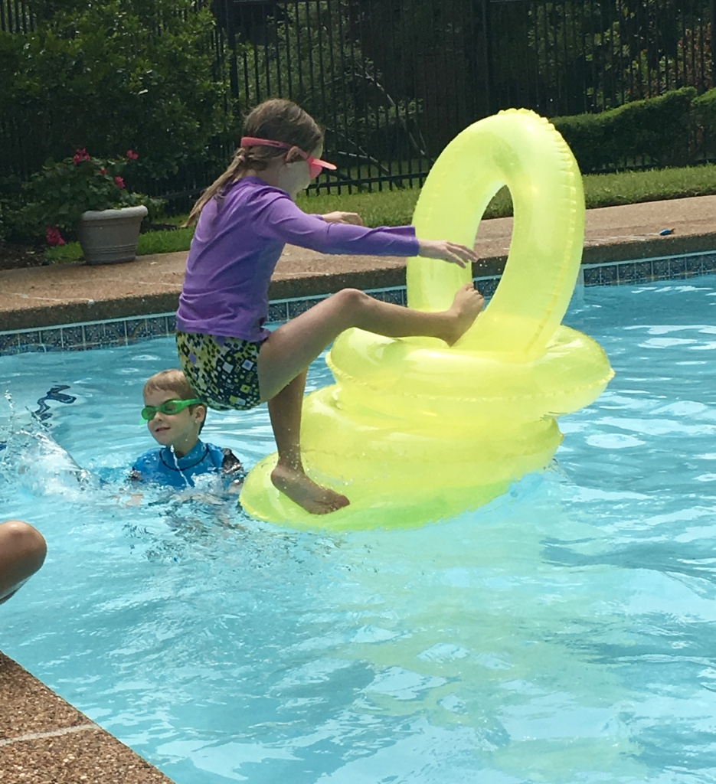

Slide 4
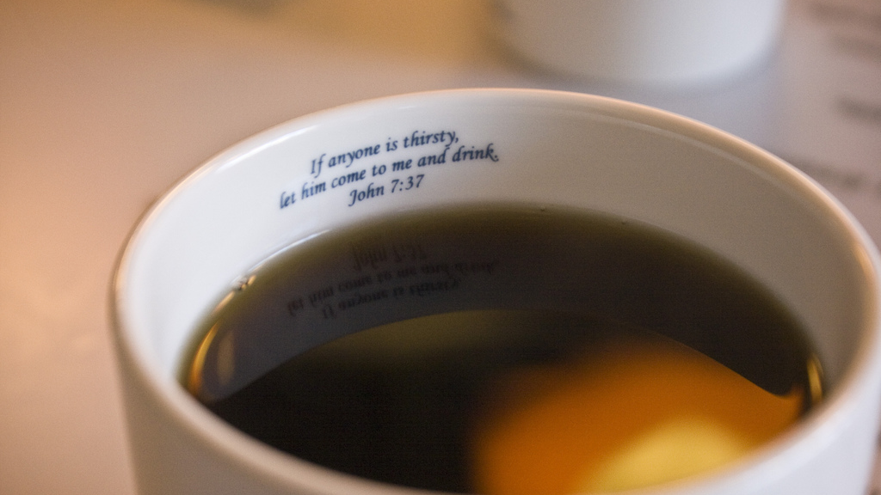
How to READ the Bible

Slide 5
How to READ the Bible
Pray
Start with easier books
  John
  Philippians
  2 Timothy
  Psalms

Slide 6
How to READ the Bible
Pray
Start with easier books
Read whole chapters
Re-read multiple times
Mark up your Bible

Slide 7
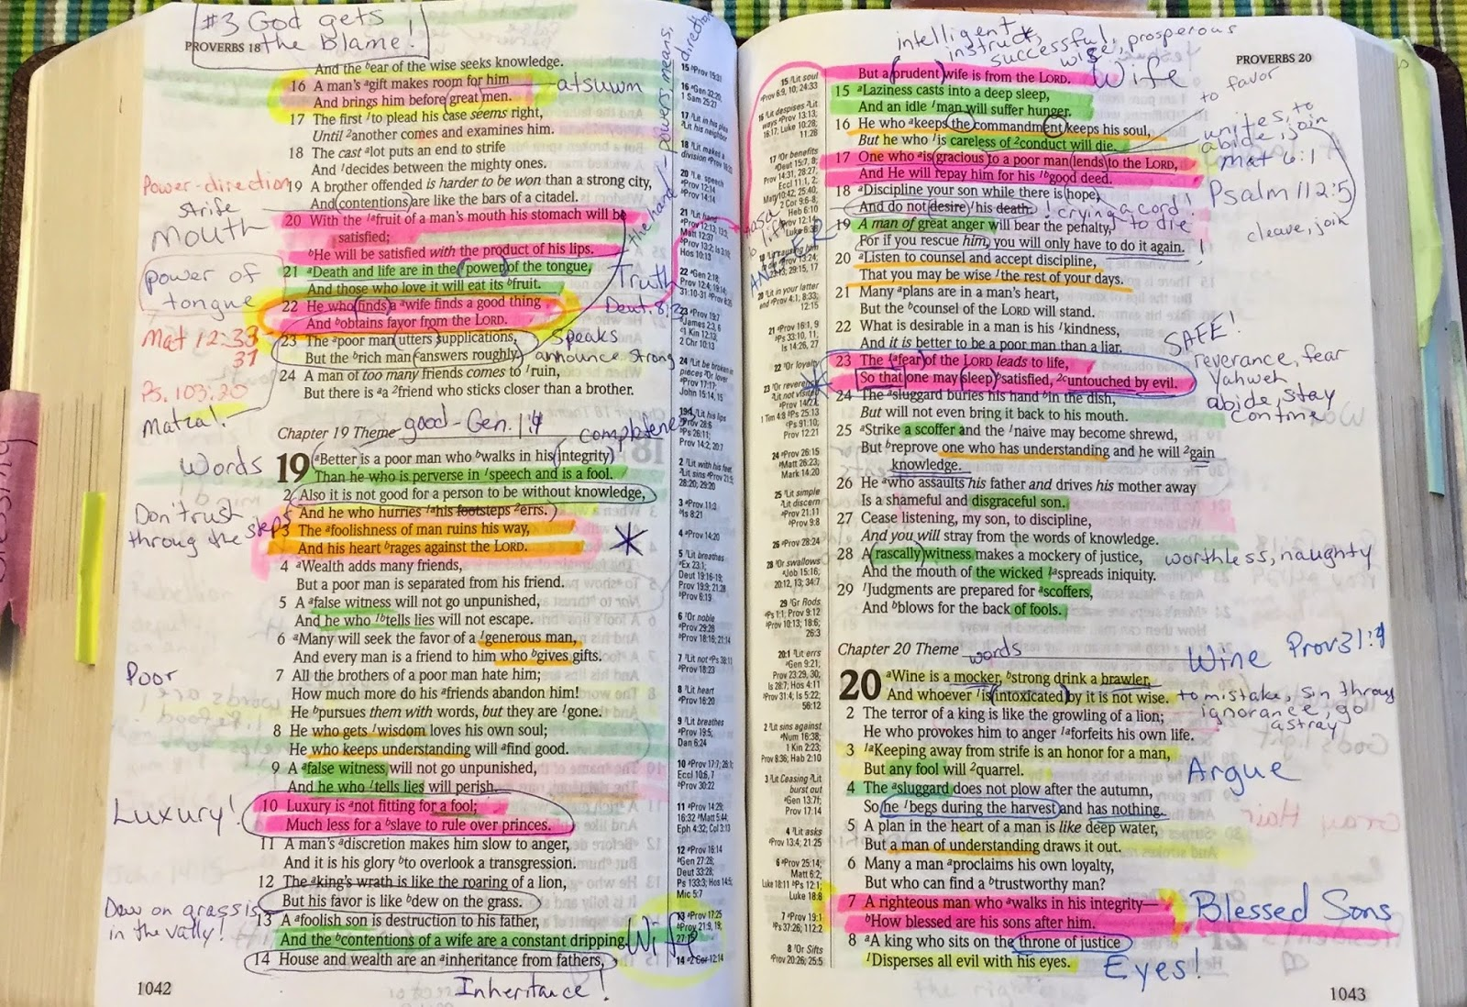

Slide 8
How to READ the Bible
Pray
Start with easier books
Read whole chapters
Re-read multiple times
Mark up your Bible
Memorize

Slide 9
How to STUDY the Bible
Identify the Big Idea
Compare Translations

Slide 10
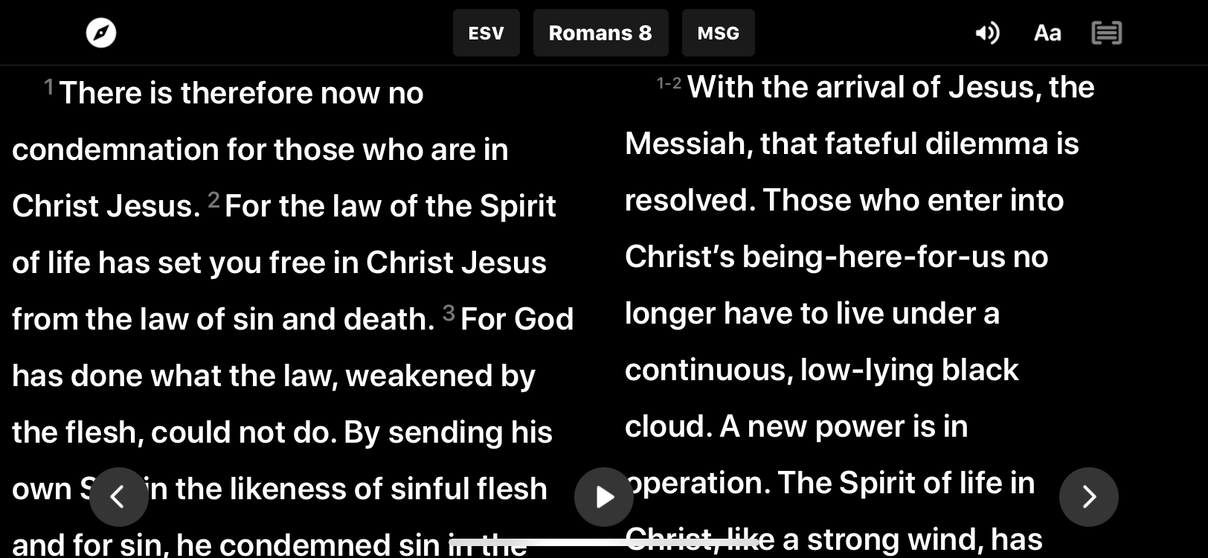
YouVersion App

Slide 11
How to STUDY the Bible
Identify the Big Idea
Compare translations
Context, context, context
    of the passage
    of the book
    of the Bible

Slide 12
How to STUDY the Bible
Identify the Big Idea
Compare translations
Context, context, context
Look up key words

Slide 13
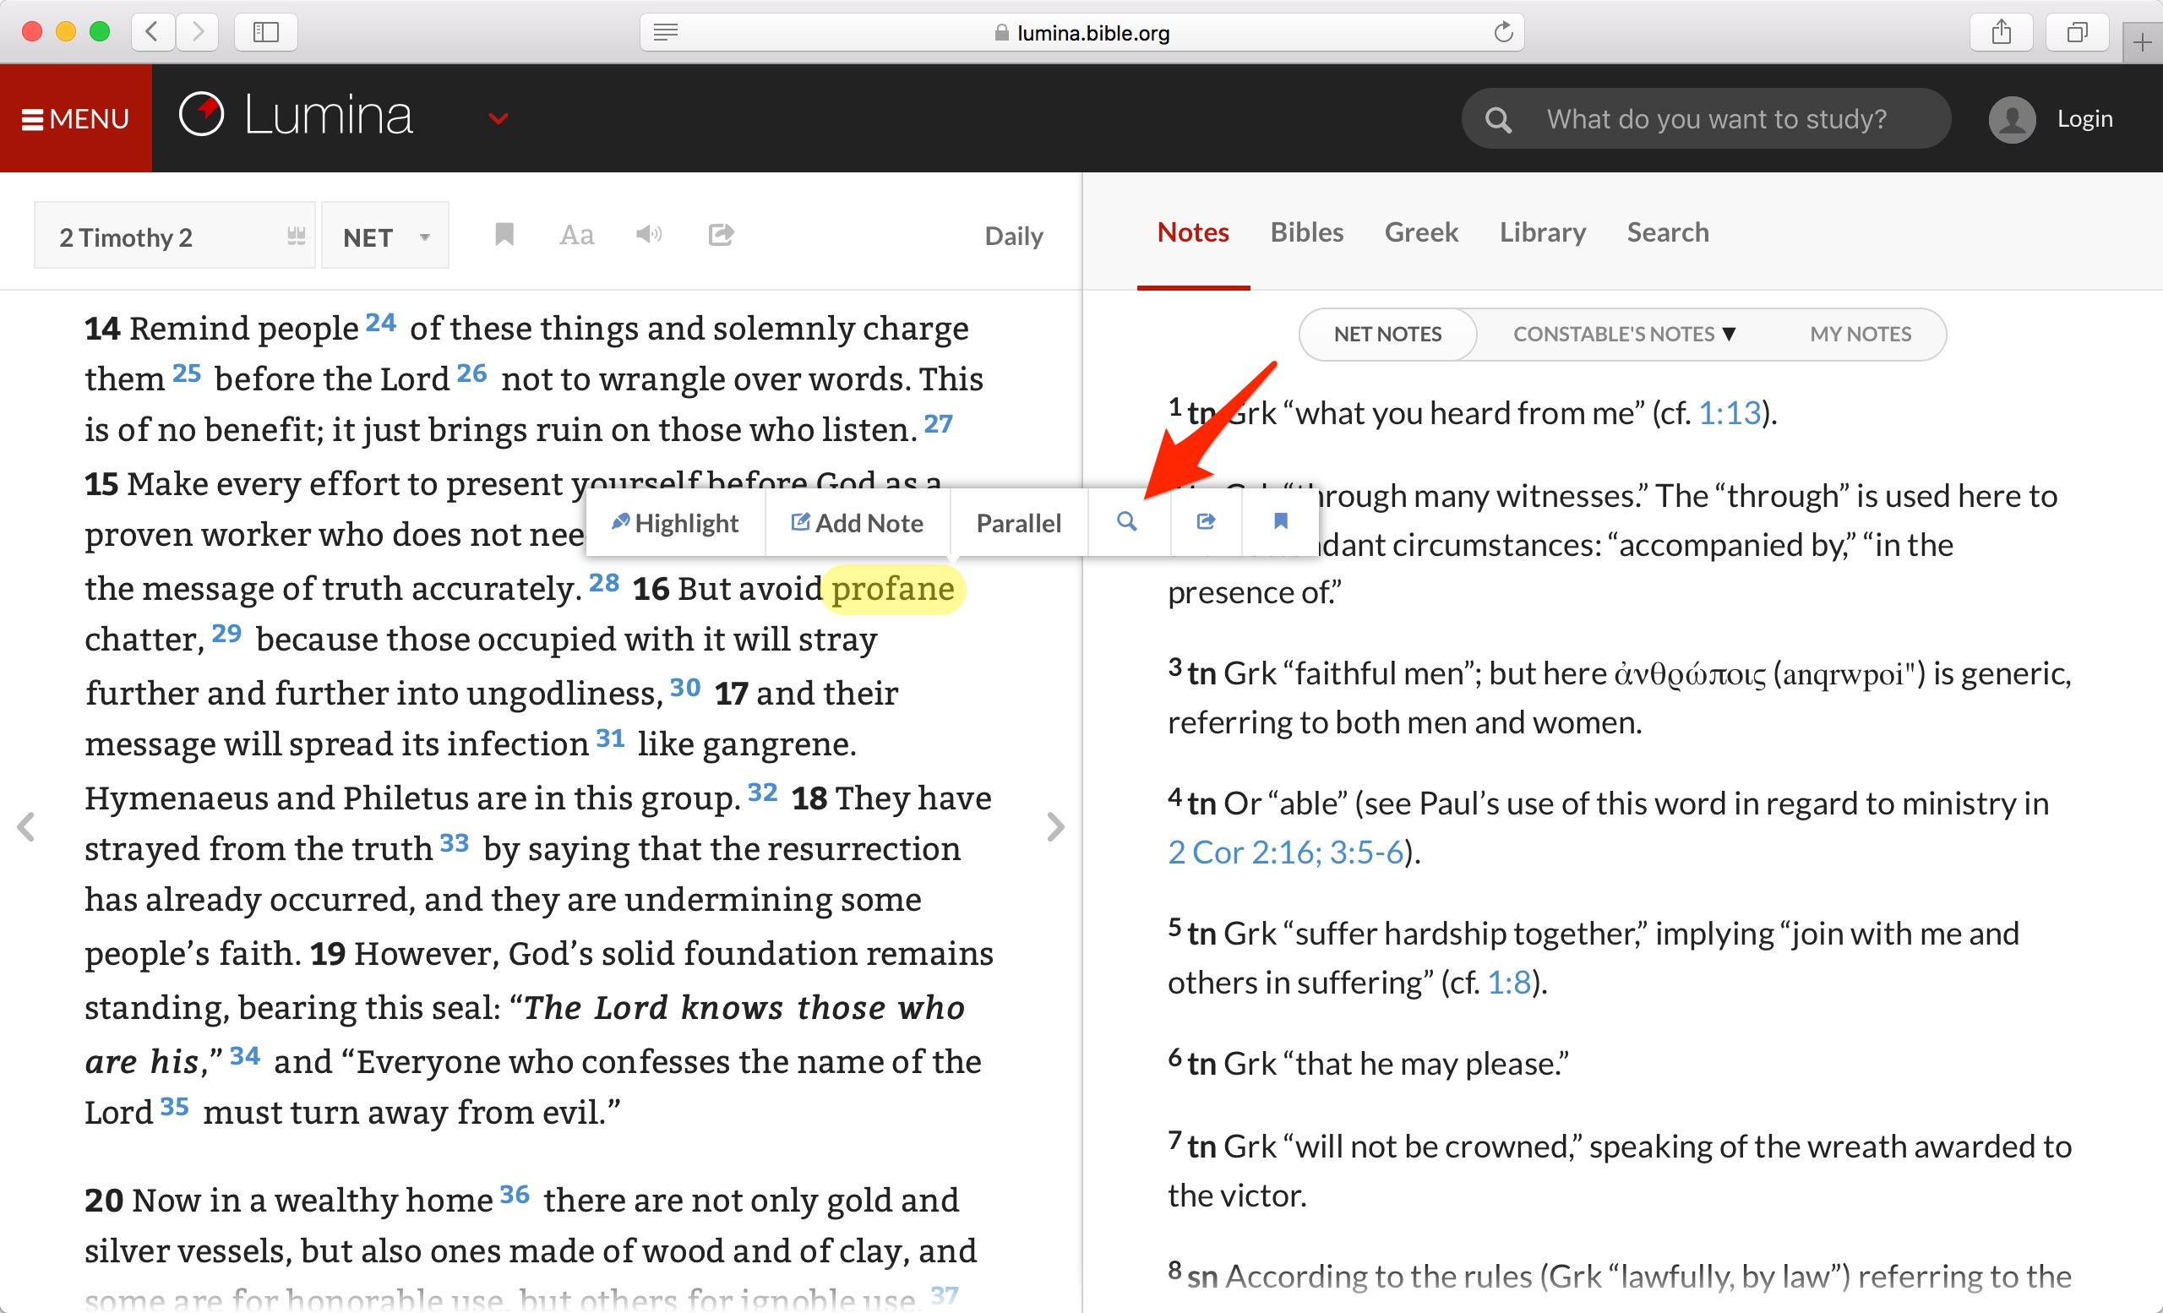
netbible.org

Slide 14
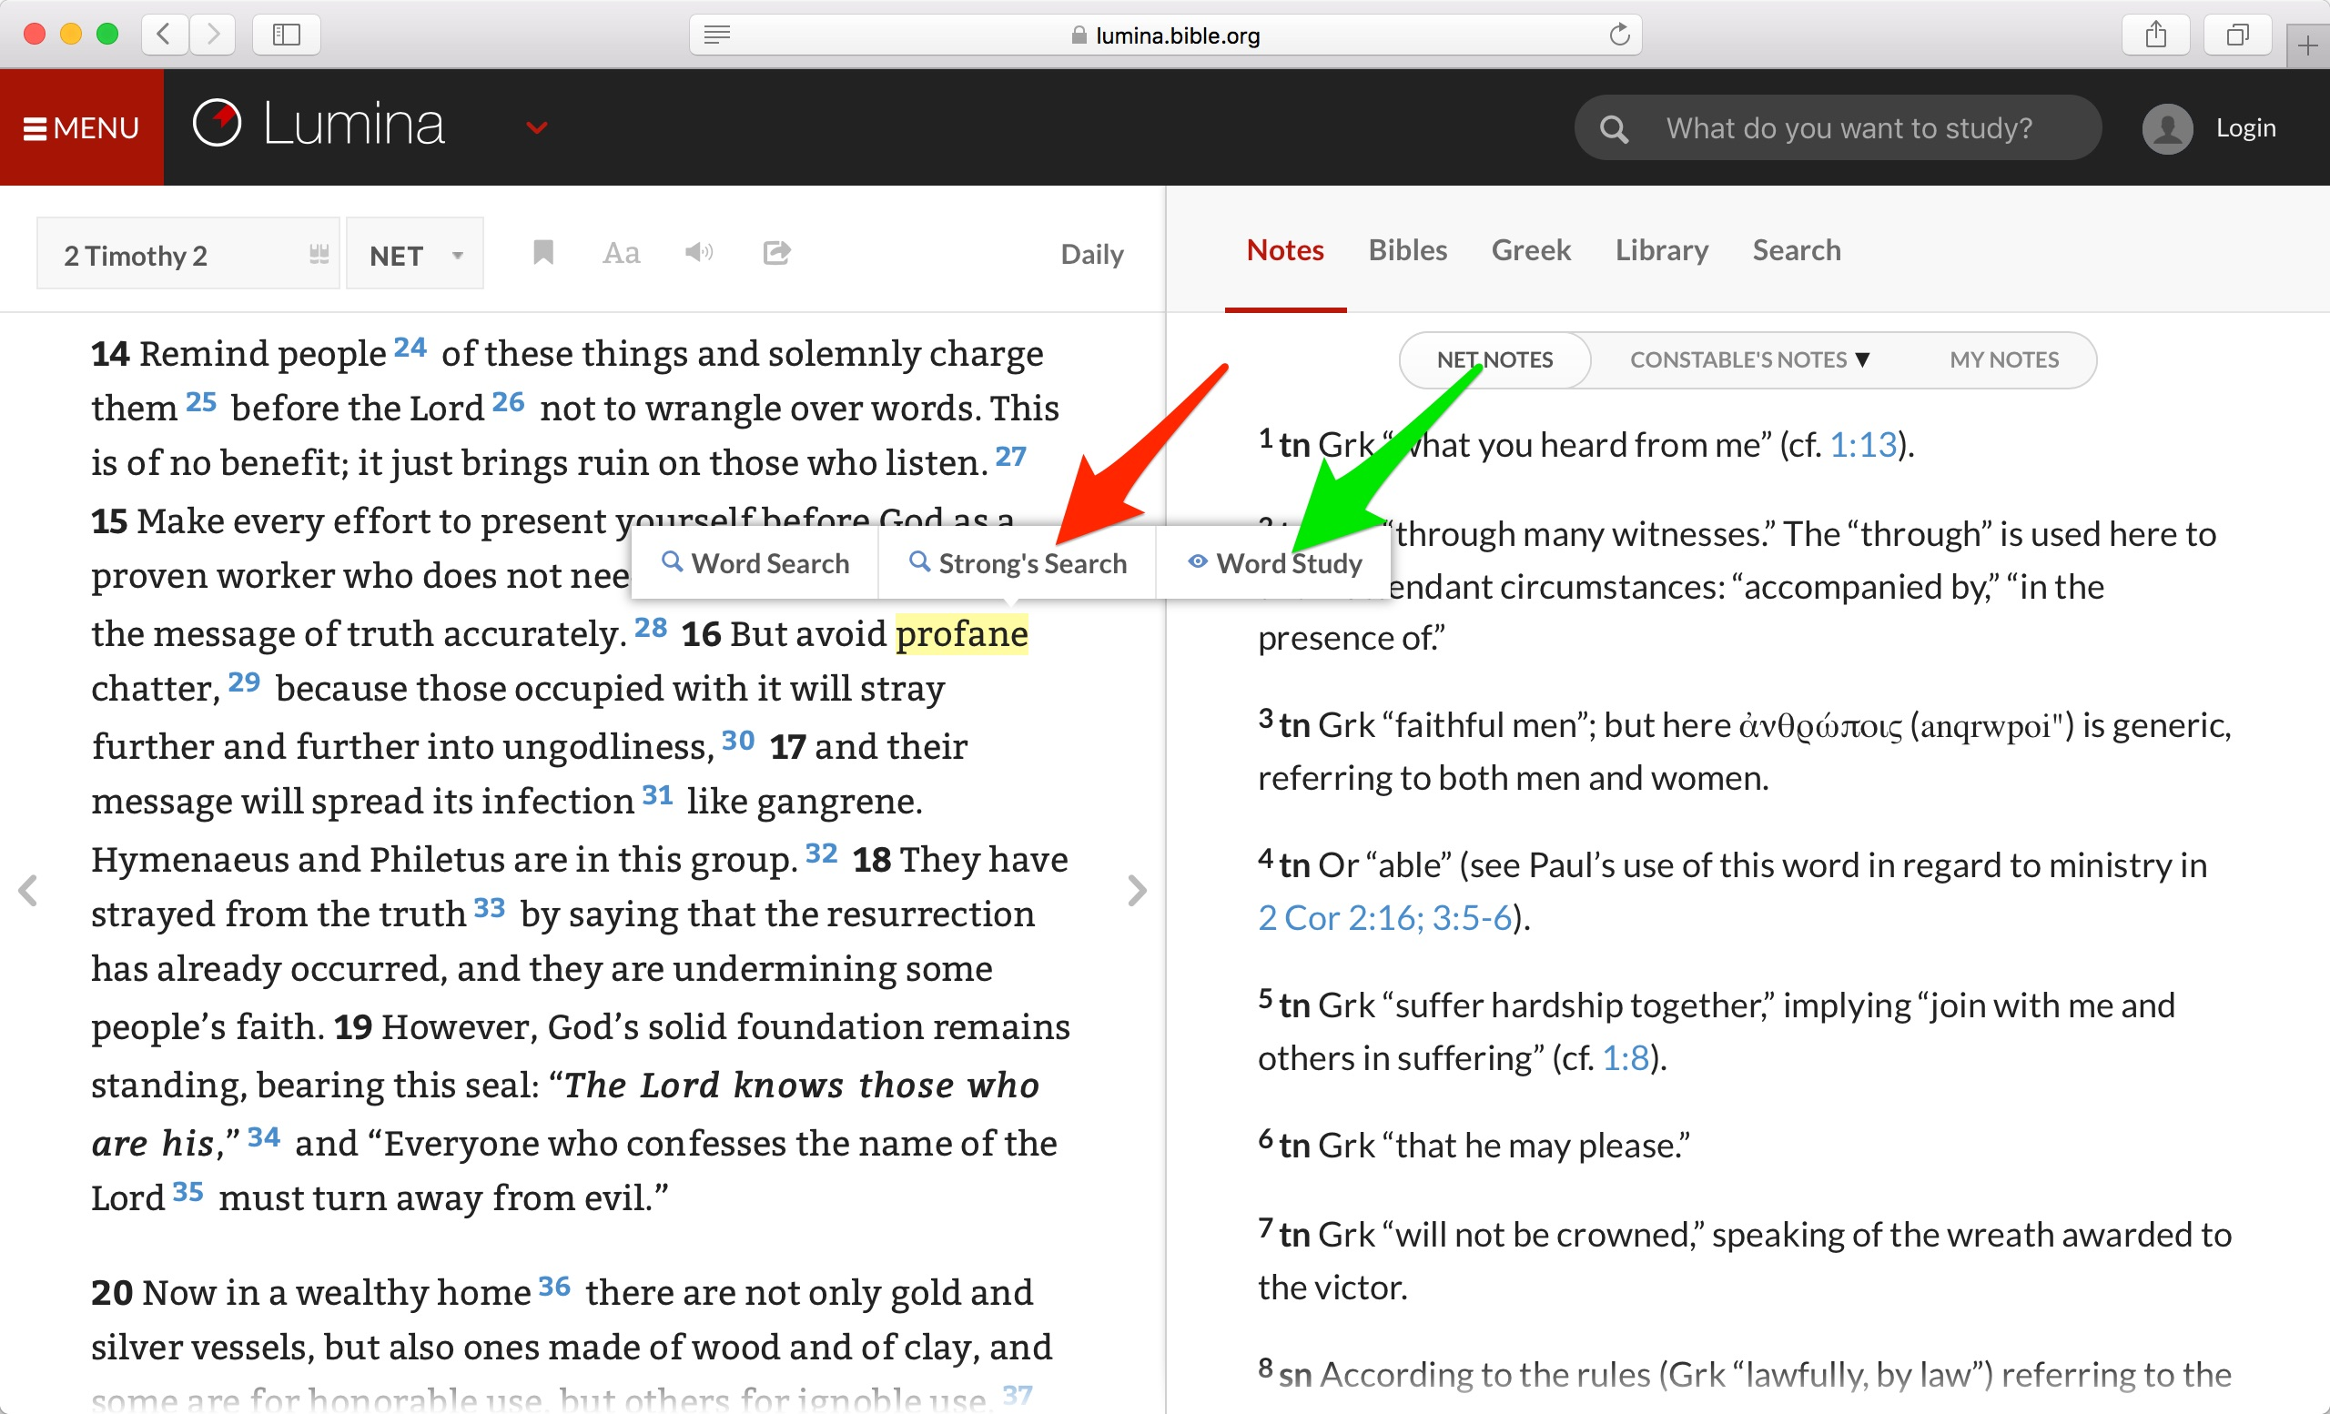

Slide 15
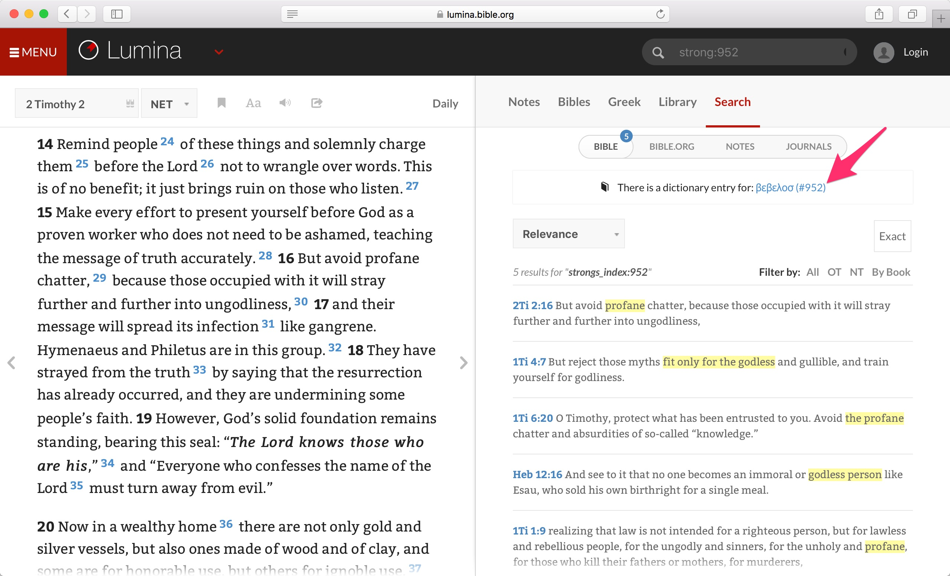

Slide 16
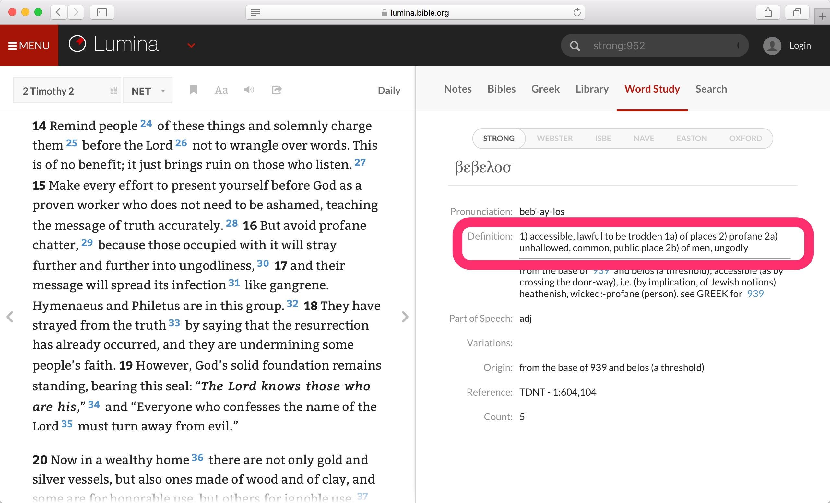

Slide 17
How to STUDY the Bible
Identify the Big Idea
Compare translations
Context, context, context
Look up key words
Consult commentaries

Slide 18
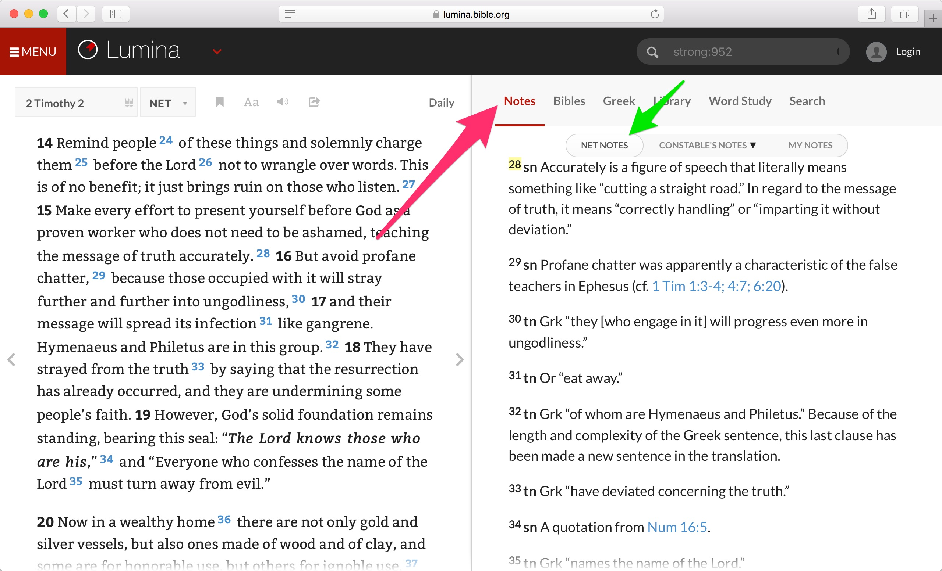

Slide 19
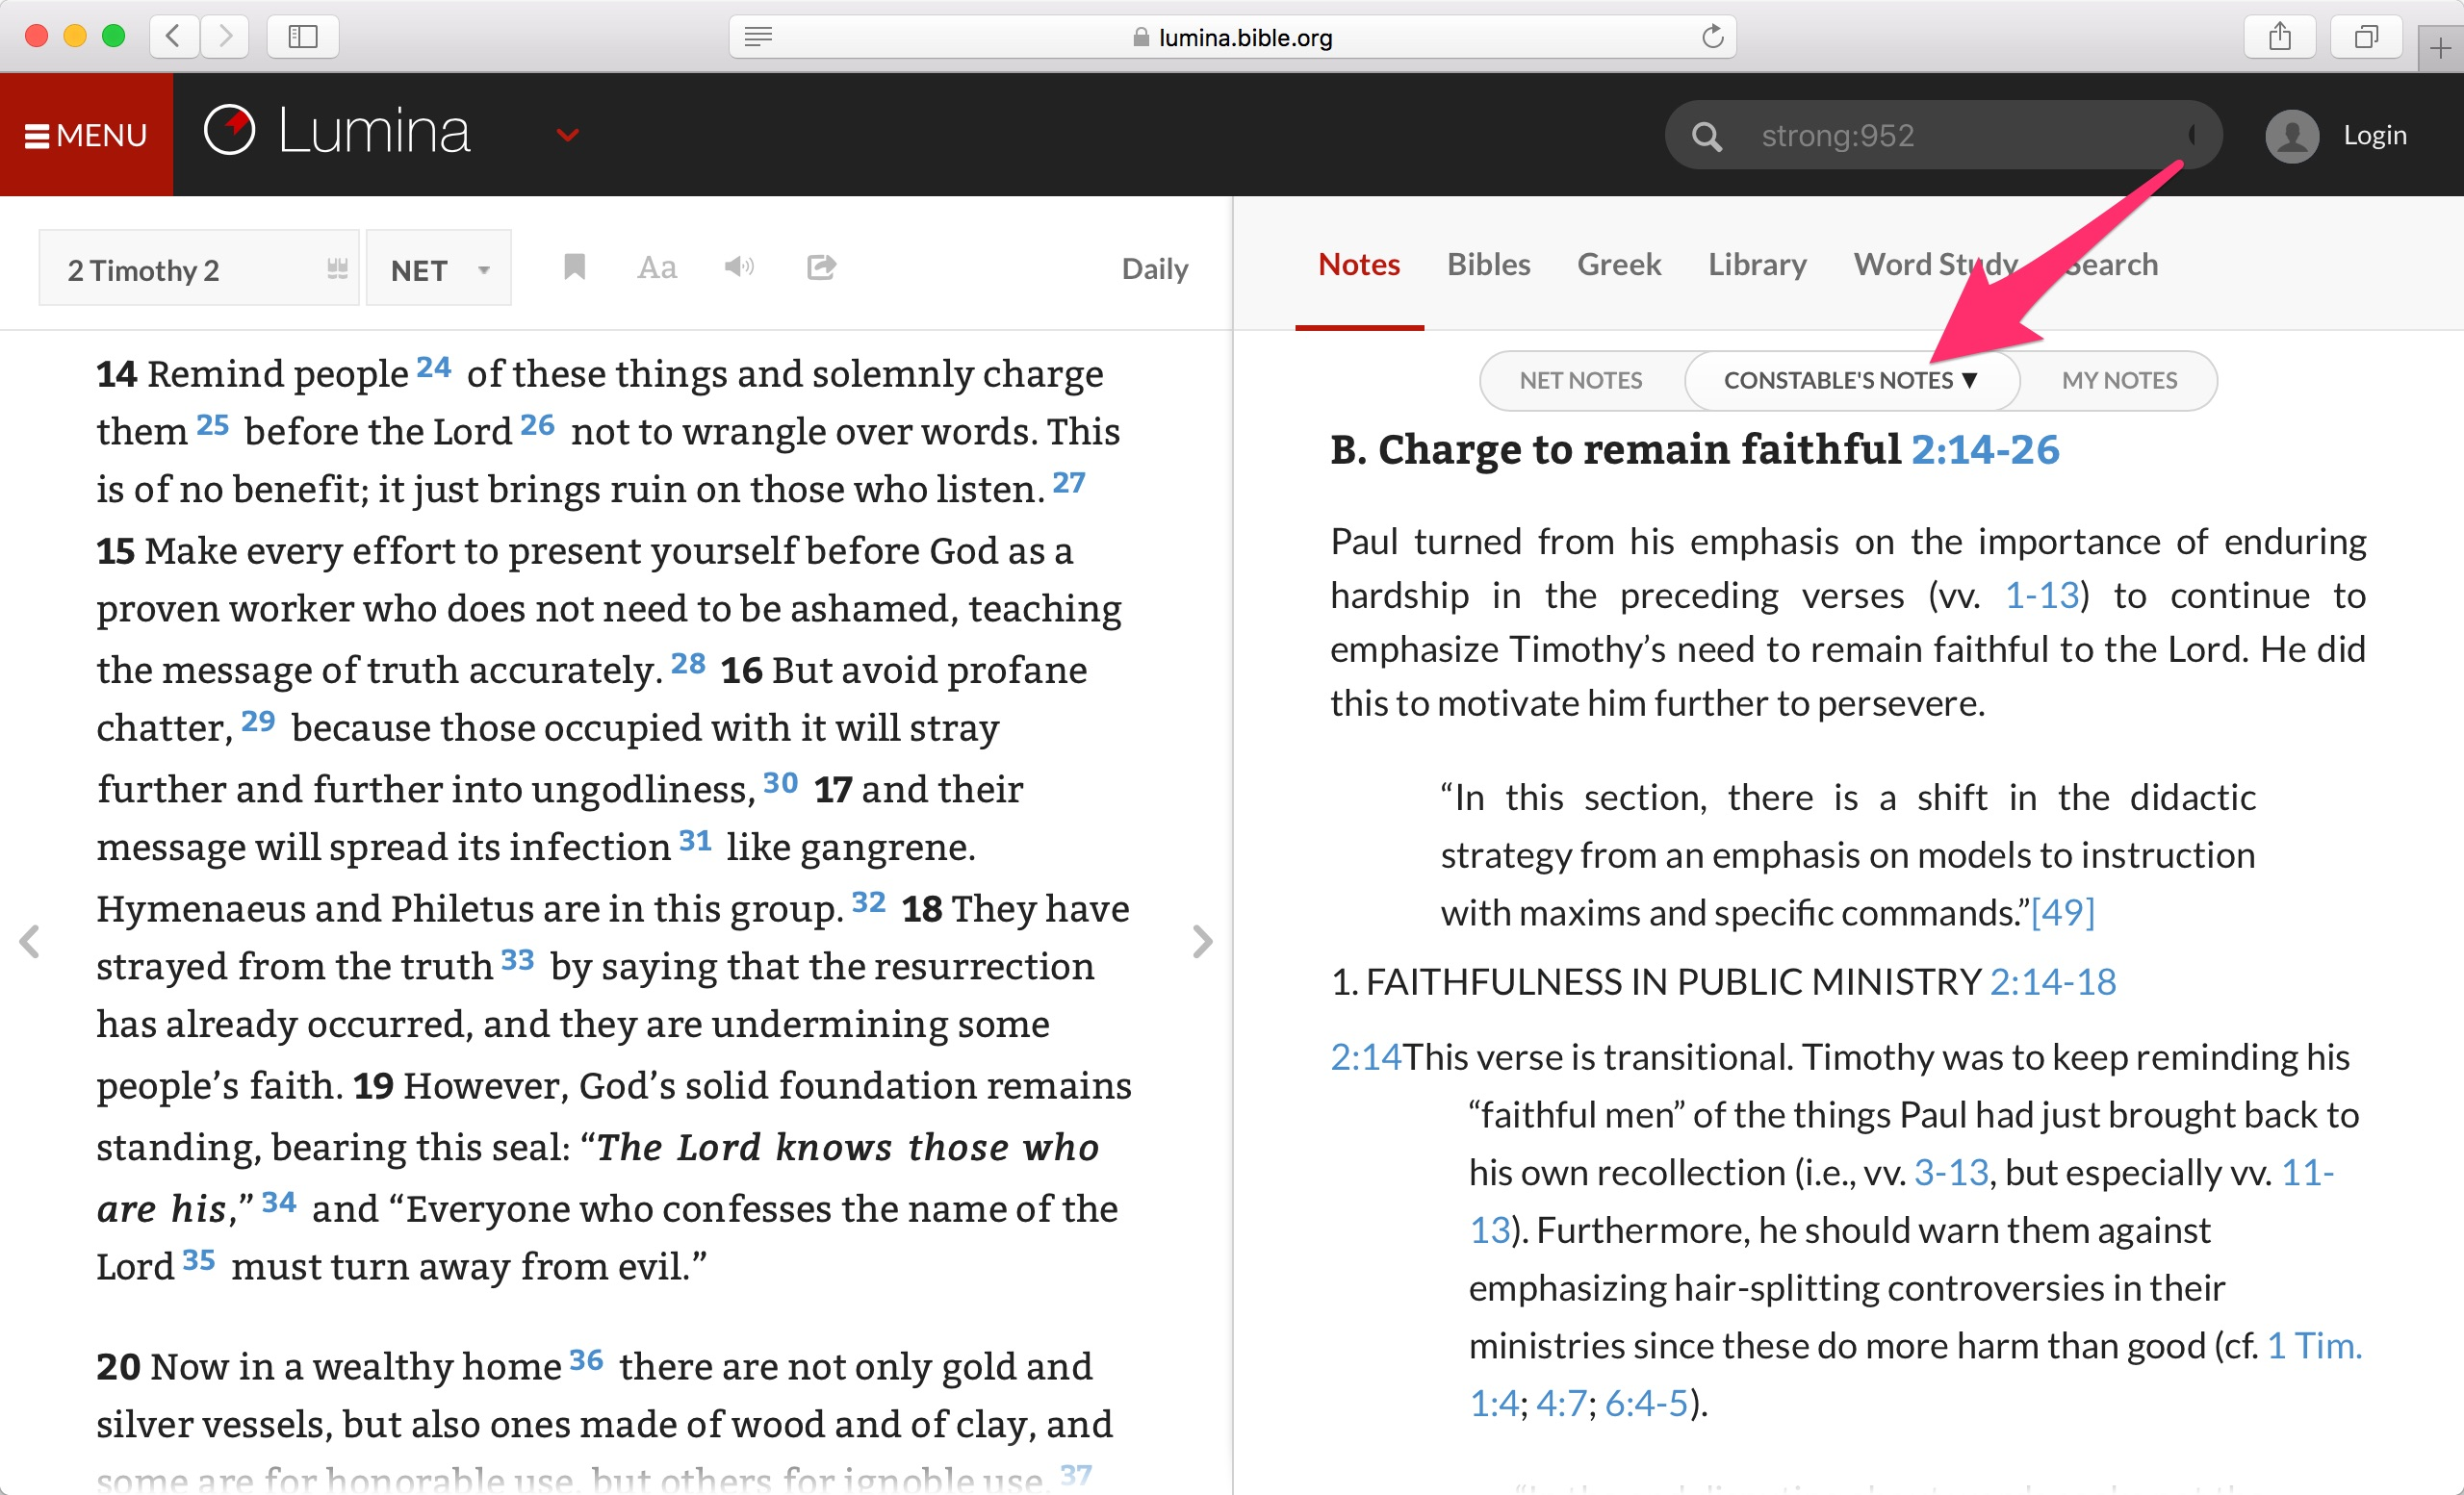

Slide 20


Slide 21
How to STUDY the Bible
Identify the Big Idea
Compare translations
Context, context, context
Look up key words
Consult commentaries
Discuss with others

Slide 22
How to APPLY the Bible
John 14:21
“The person who has my commandments and obeys them is the one who loves me. The one who loves me will be loved by my Father, and I will love him and will reveal myself to him.”

Slide 23
How to APPLY the Bible
Is there a truth to believe?
Is there a sin to confess?
Is there a behavior to change?
Is there an example to follow?

Slide 24
Resources
YouVersion App
netbible.org
How to Study your Bible by Kay Arthur
Living by the Book by Howard Hendricks

Slide 25
Romans 8:26-39
Read it 3 times in 2 translations
Mark it up
  Underline 5 key words; circle 3 words you need to study
  Box all references to God
  Highlight or double underline most important phrases
Write big idea in one, short sentence
Create one application… make it specific!

